Slide 1
Master Food Value Chain Management
Fakultätsratssitzung
07.02.2024
Professor Dr. Ralf Schlauderer
Hochschule Weihenstephan-Triesdorf (HSWT)
University of Applied Sciences

Slide 2
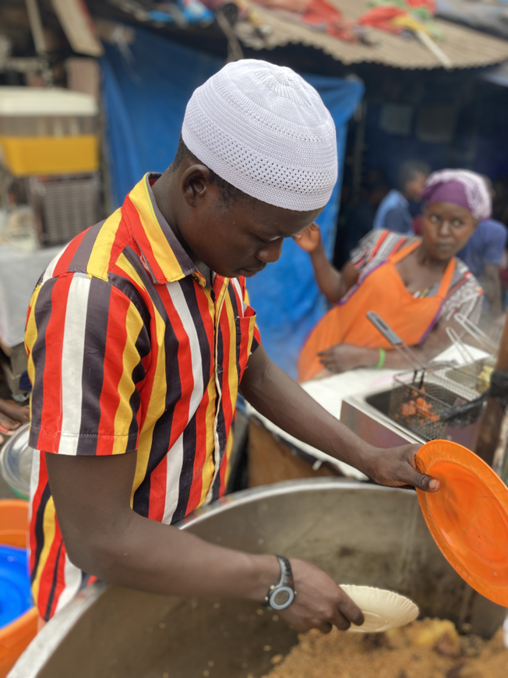
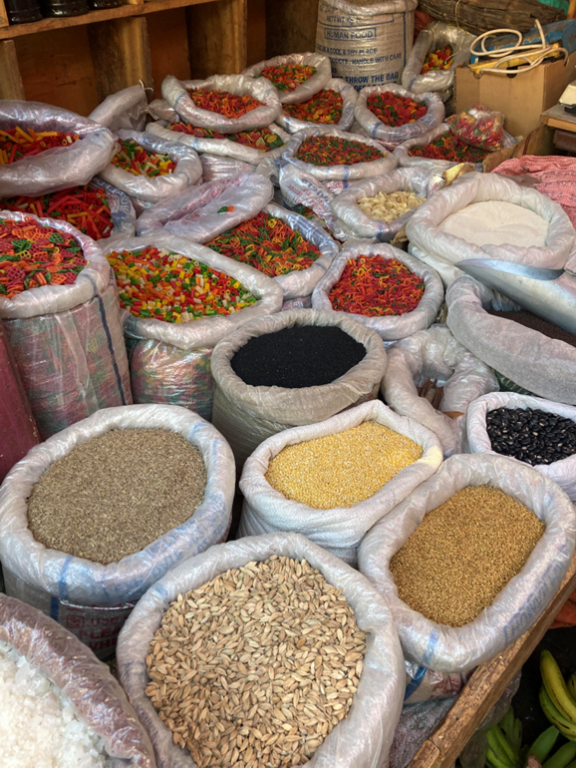
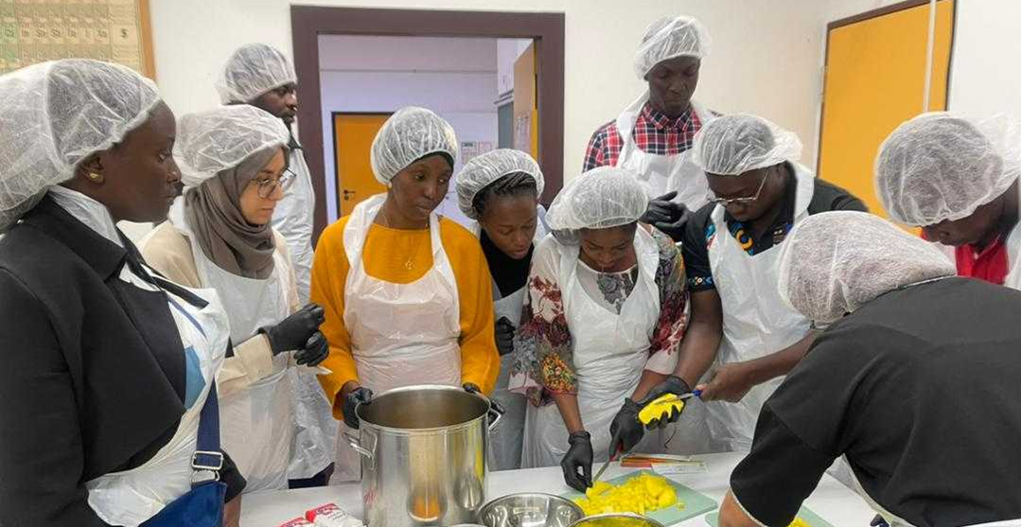
Erasmus+ CBHE Project CHAIN – 101082963
Partner Institutions:
University of Applied Sciences
Weihenstephan-Triesdorf (HSWT)
University of Kara
University of Lome
South Eastern Kenya University
Jaramogi Oginga Odinga University
of Science and Technology
Farming Systems Kenya
Federal University of Technology Minna
Alex Ekwueme Federal University
Ndufu Alike
Uniwesytet Przyrodniczy We Wroclawiu
Universitatea Pentru Stiintele Vietii
„Ion Ionescu de la Brad“ Din Iasi
Project objectives:
To support modernization of agricultural education in Togo, Nigeria and Kenya by fostering a more holistic and human-centred approach to agricultural education, training and innovation.
Development of a master program in Food Value Chain (FVC) at six partner universities in Kenya, Nigeria and Togo.
01.06.2023 – 31.05.2026
Contact:
Dr. Bernd Müller
Weihenstephan-Triesdorf University of Applied Sciences
bernd.mueller@hswt.de

Slide 3
Master Food Value Chain Management (MFC)
WS 25/26
SS 25
WS 26/27
SS 26
WS 27/28
SS 27
Study Start of 25 students | 1. Semester = practical semester | 2. Semester | 3. Semester | 4. Semester
Study Start of 35 students |  |  | 1. Semester = practical semester | 2. Semester | 3. Semester | 4. Semester
Study Start of 50 students |  |  |  |  | 1. Semester = practical semester | 2. Semester

Slide 4
Master Food Value Chain Management (MFC)
5 ECTS
1. Semester = practical semester | Introduction to Food Value Chain Management | Internship (Report + Oral Examination)
2. Semester | Introduction and Science of Raw Materials | Food Technology | Food Economics | Food Quality Management | Scientific Working + Data Management | Elective Module Group A
3. Semester | Trends and Innovations in Value Chains | Food Marketing | Institutional and Environmental Economics | Interdisciplinary Research Project | Elective Module Group B | Elective Module Group C
4.Semester | Project Planning and Management | Scientific Working | Master Thesis

Slide 5
Master Food Value Chain Management (MFC)
Group of elective modules A
831900100 Seminar in Crop Production and Livestock Production
831900110 Seminar in Agricultural Engineering and Crop Production
831900120 Seminar in Livestock Production and Agricultural Engineering
960400040 Deutsch als Fremdsprache - Aufbaustufe (B1 GER)
Group of elective modules B
830100050 Agricultural Operating Systems / Consulting Methodology
830300010 Cooperative Entrepreneurship / Agricultural Operating Systems
830300020 Consulting Methodology / Cooperative Entrepreneurship
960400040 Deutsch als Fremdsprache - Aufbaustufe (B1 GER)
Group of elective modules C
830900050 International Trade
831800070 Renewable Energies
831900130 Sustainable Regional Development
960400040 Deutsch als Fremdsprache - Aufbaustufe (B1 GER)

