Slide 1
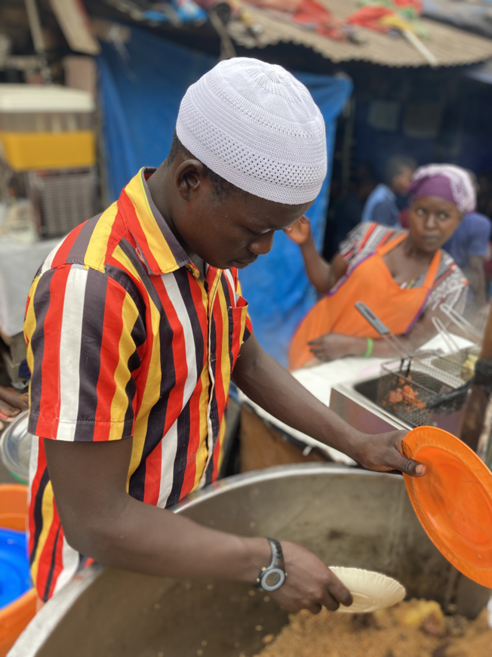
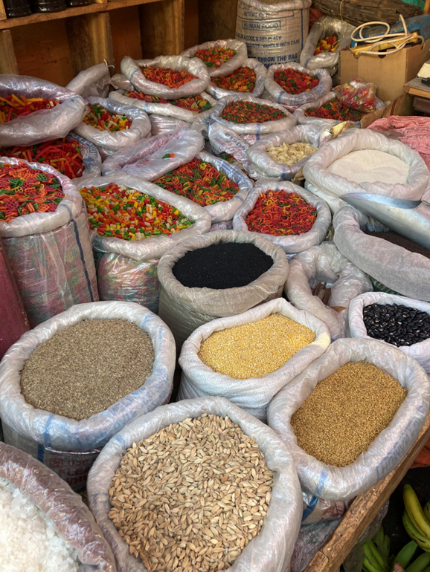
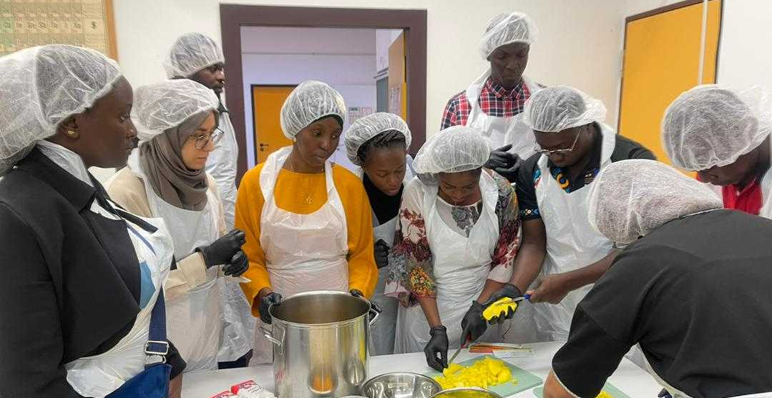
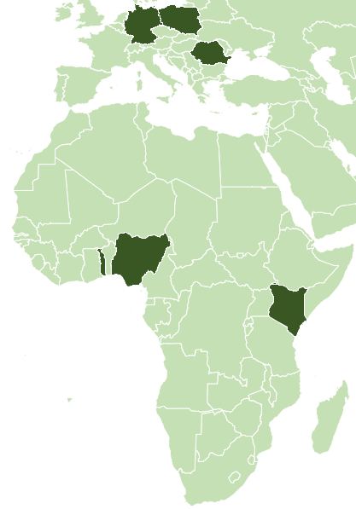
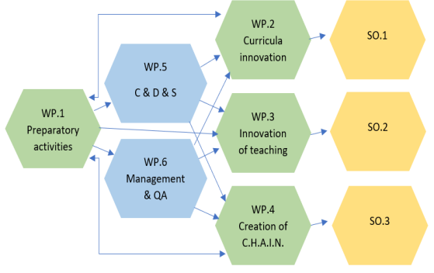
Erasmus+ CBHE Project CHAIN – 101082963
Cooperation for Holistic Agriculture Innovation Nests in
Sub-Saharan Africa
CHAIN steps up the agricultural innovation and collaboration potential in SSA targeting engagement of university staff, agricultural students, farmers and industry representatives. It introduces a more holistic and human-centred approach to agricultural education and innovation in the region through: developing a master program in Food Value Chain (FVC) at beneficiary HEIs; building teacher capacity and establishing Collaborative Holistic Agriculture Innovation Nests offering support to innovation initiatives of students, farmers, and entrepreneurs.
©Australian Bureau of Statistics, GeoNames, Geospatial Data Edit, Microsoft, Microsoft Crowdsourced Enrichments, Navinfo, Open Places, OpenStreetMap, TomTom, Wikipedia, Zenrin, supported by Bing
Project objectives:
To support modernization of agricultural education in Togo, Nigeria and Kenya by fostering a more holistic and human-centred approach to agricultural education, training and innovation.
Partner Institutions:
University of Applied Sciences
Weihenstephan-Triesdorf (HSWT)
University of Kara
University of Lome
South Eastern Kenya University
Jaramogi Oginga Odinga University
of Science and Technology
Farming Systems Kenya
Federal University of Technology Minna
Alex Ekwueme Federal University
Ndufu Alike
Uniwesytet Przyrodniczy We Wroclawiu
Universitatea Pentru Stiintele Vietii
„Ion Ionescu de la Brad“ Din Iasi
Logic of intervention:
01.06.2023 – 31.05.2026
Contact:
Dr. Bernd Müller
Weihenstephan-Triesdorf University of Applied Sciences
bernd.mueller@hswt.de

Slide 2
Erasmus+ CBHE Project CHAIN – 101082963
Cooperation for Holistic Agriculture Innovation Nests in
Sub-Saharan Africa
CHAIN steps up the agricultural innovation and collaboration potential in SSA targeting engagement of university staff, agricultural students, farmers and industry representatives. It introduces a more holistic and human-centred approach to agricultural education and innovation in the region through: developing a master program in Food Value Chain (FVC) at beneficiary HEIs; building teacher capacity and establishing Collaborative Holistic Agriculture Innovation Nests offering support to innovation initiatives of students, farmers, and entrepreneurs.
©Australian Bureau of Statistics, GeoNames, Geospatial Data Edit, Microsoft, Microsoft Crowdsourced Enrichments, Navinfo, Open Places, OpenStreetMap, TomTom, Wikipedia, Zenrin, supported by Bing
Project objectives:
To support modernization of agricultural education in Togo, Nigeria and Kenya by fostering a more holistic and human-centred approach to agricultural education, training and innovation.
Partner Institutions:
University of Applied Sciences
Weihenstephan-Triesdorf (HSWT)
University of Kara
University of Lome
South Eastern Kenya University
Jaramogi Oginga Odinga University
of Science and Technology
Farming Systems Kenya
Federal University of Technology Minna
Alex Ekwueme Federal University
Ndufu Alike
Uniwesytet Przyrodniczy We Wroclawiu
Universitatea Pentru Stiintele Vietii
„Ion Ionescu de la Brad“ Din Iasi
Logic of intervention:
01.06.2023 – 31.05.2026
Contact:
Dr. Bernd Müller
Weihenstephan-Triesdorf University of Applied Sciences
bernd.mueller@hswt.de

